Slide 1

LEVELUP
Presented by:-
Devansh Kopra - 21107013
Ayush Mistry - 21107029
Mayank Kumar – 21107016
Sahil Mujumdar - 21107050
Project Guide -
Ms. Poonam Pangarkar

Slide 2
Introduction :
In today's fast-paced world, we understand the importance of accessible and flexible learning
Our platform is designed to empower learners of all backgrounds, providing a rich and interactive educational experience
From skill-building to advanced subjects, we offer a diverse range of courses curated by experts
Problem Identified:
Traditional way of learning
Lack of focus
Limited organizational skills
Reading difficulties

Slide 3
Problem Solution:
LevelUp is a Personalized e-learning that is designed to:-
Enhance learning Experience - LevelUp provides interactive content and helps enhance learner’s skills and boosts his/her knowledge
Accessibility to Quality Education- It ensures that high-quality educational content is readily available to everyone, regardless of their location, time and prior knowledge of the topic

Slide 4
Objectives :
To Enhance the learning experience : LevelUp provides interactive video lessons which keeps the learner engaged and excited about learning
Flexible Learning : LevelUp offers flexibility in learning schedules , allowing the learner to learn from the comfort of their own space
Varied Learning Resources : The Web Application offers a diverse range of study resources which includes short video lectures about the topic
Accessibility To Quality Education : LearnUp ensures that only high quality and appropriate educational content is provided to their learners, regardless of their location

Slide 5
Scope :
Diverse Subject Matter : LevelUp covers a wide array of subjects, from academic topics like mathematics, science, and history to practical skills such as coding, graphic design, and digital marketing
Global Reach : LevelUp has a global reach, enabling students from different parts of the world to access the same courses and resources
Customization: LevelUp can tailor courses to meet the specific needs of individual learners. Personalization through adaptive learning technologies can help students progress at their own pace
Lifelong Learning: E-learning platforms can serve learners of all ages, promoting lifelong learning

Slide 6
Features :
Simple and Intuitive Interface : LevelUp has a very easy and simple to understand user interface with bright visuals to immediately attract the learner’s attention and help them navigate them easily throughout the web application
Planned and Responsive Courses : All the courses have been designed to adapt to the individual needs and progress of learners
Personalization : LevelUp provides personalized learning paths , giving the learner a vast variety of courses to choose from app
Thinking Skills : LevelUp also includes courses on practical skills

Slide 7
Project Outcome :
Increased Access to Education: One of the primary outcomes of LearnUp is to provide greater access to education and learning resources. This includes reaching a global audience, making education more affordable, and offering flexible learning options
Improved Learning Experience: LevelUp aims to enhance the learning experience for students. This is achieved through interactive content, multimedia resources and user-friendly interfaces
Diverse Course Offerings: Another outcome is to offer a wide range of courses and learning materials catering to different subjects, levels, and interests

Slide 8
Technology Stack :
FRONT END :-
HTML 5
CSS-4.15
JS
BACK END :-
PHP-8.2.0

Slide 9
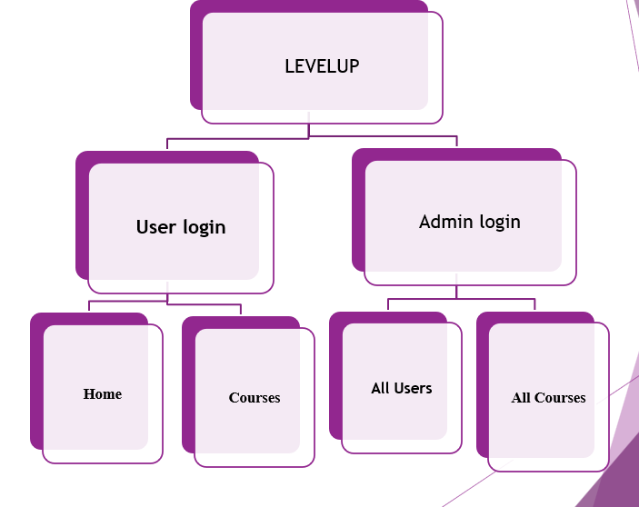
Block Diagram

Slide 10
Thank You...!!

